Slide 1


Analysing the impact of Covid on suicide rates in the UK

Slide 2

A Project By: James Hands Gussie Poole Siobhan Brindley Hardip Jandu

Slide 3
Project Outline
Why Suicide rates and Covid?
How did Covid affect suicide rates in terms of their classification of deprivation?
Was the Gender split of suicide rates affected by Covid?
Was there a link between suicide rates and regions during Covid?
Hypothesis - We think the Northern areas of the country will have an increase in suicides during Covid

Slide 4
Why this project?
Mental Health is an important topic at the moment. According to the mental health charity Mind, one in four of us will experience a mental health problem in any given year. That’s 25% of the population dealing with mental health challenges, and often facing them alone.
We wanted to see whether the recent covid pandemic has had an impact on mental health and reflect now we are coming out of this period, how this has potentially affected us.
Our target area for analysis is the impact of Covid on on Suicide rates in the UK and how it has affected the population.

Slide 5

The Process – Cleaning the data

Slide 6
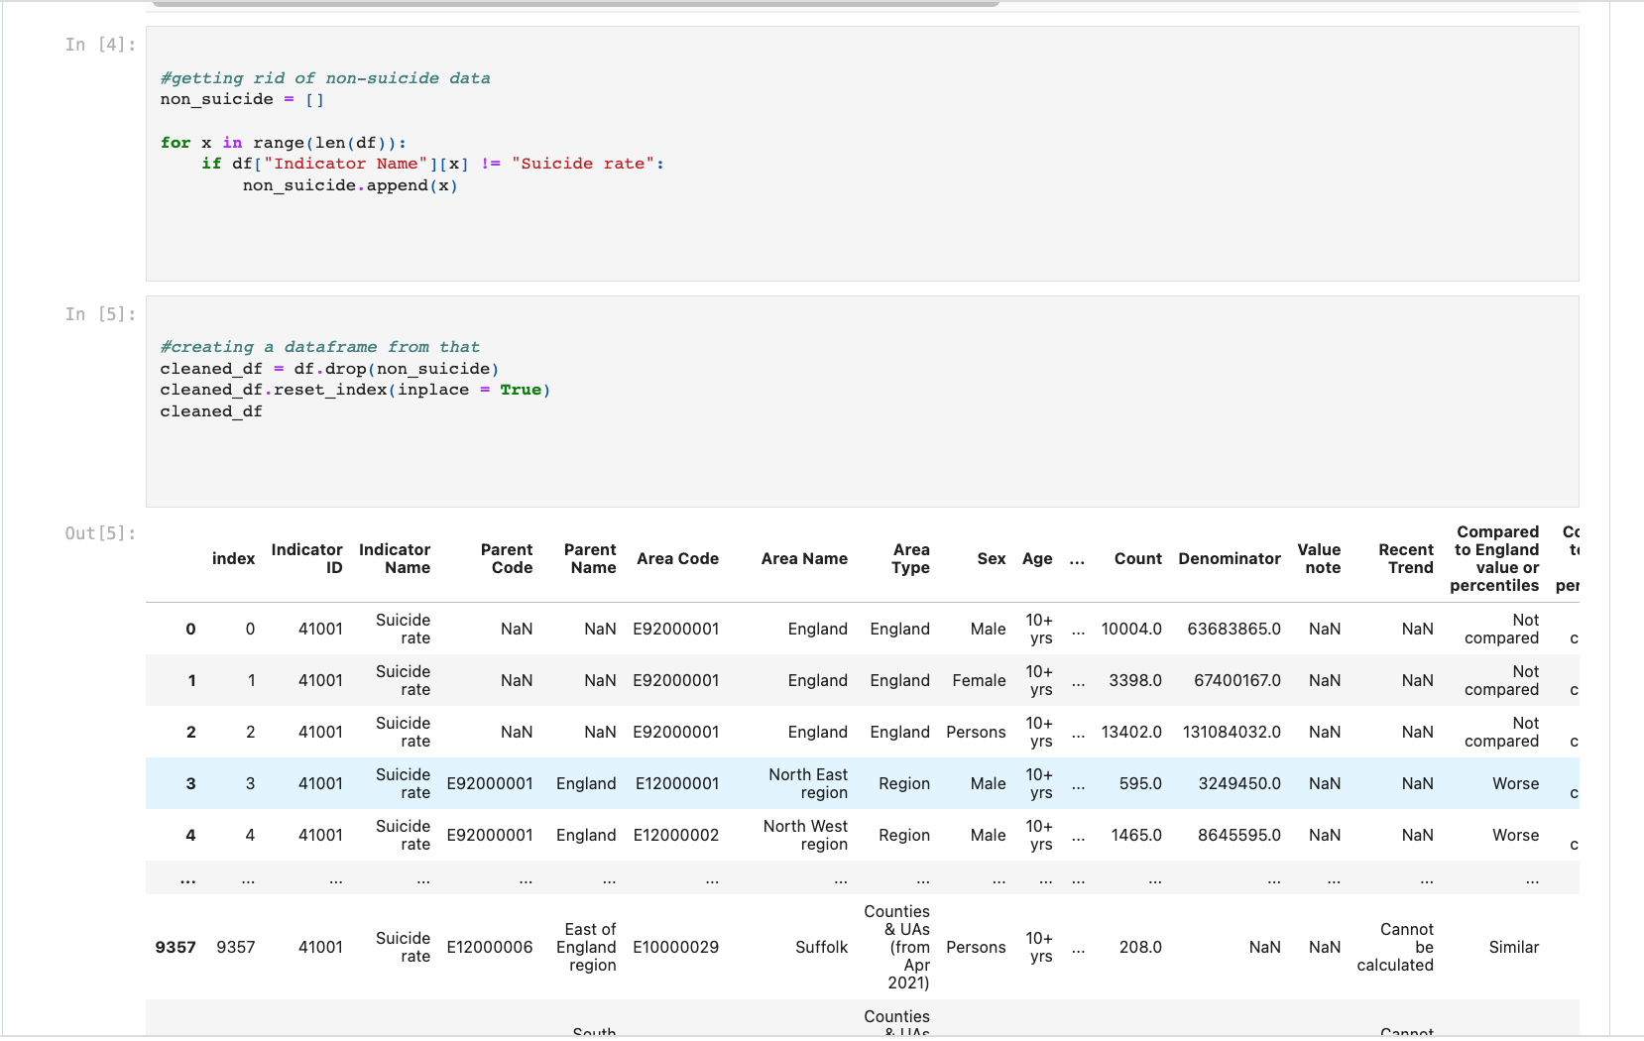
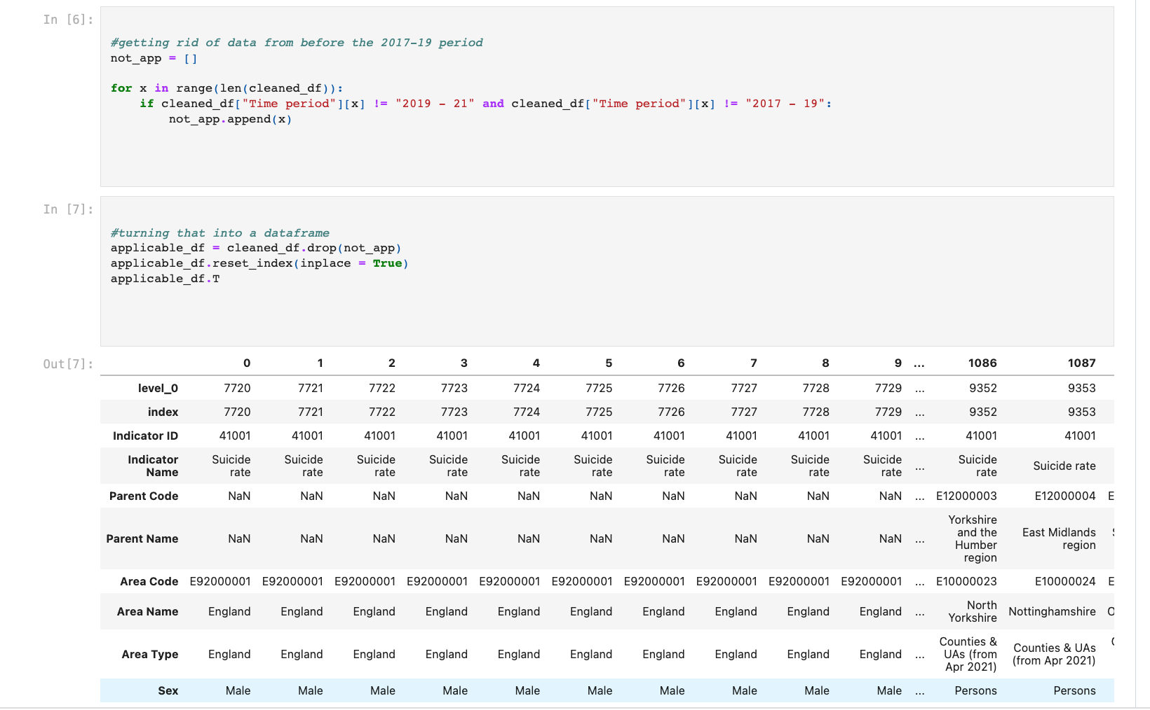
Source of the csv - Suicide Prevention Profile – OHID
We downloaded the file as a csv and imported it into Jupyter Notebook to start the clean up process.
Firstly, we needed to clear the years prior to 2017 for us to compare the pre and during covid years more accurately.

Slide 7
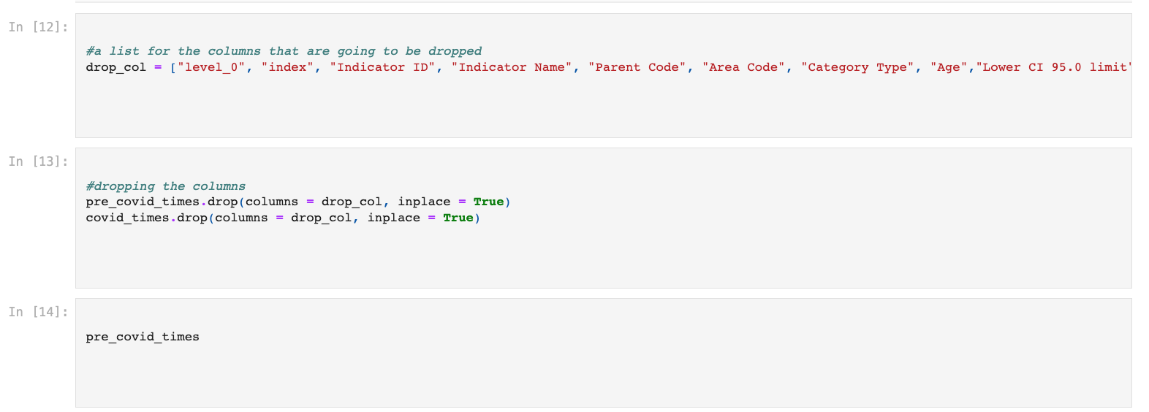
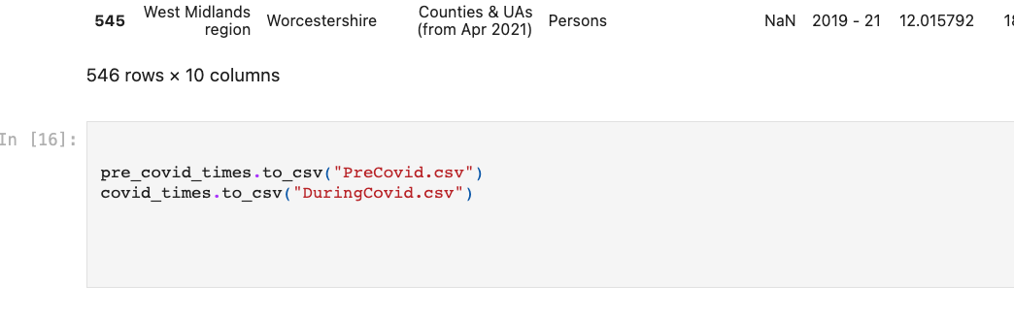
We created data frames, dropped the columns deemed unnecessary and exported them into CSV’s to examine
We could then use the CSV’s to start the analysis of the data for each of the questions we chose to look at.
We also created some more CSV’s and further cleaned the data once we had streamlined the data we wanted to focus on.

Slide 8
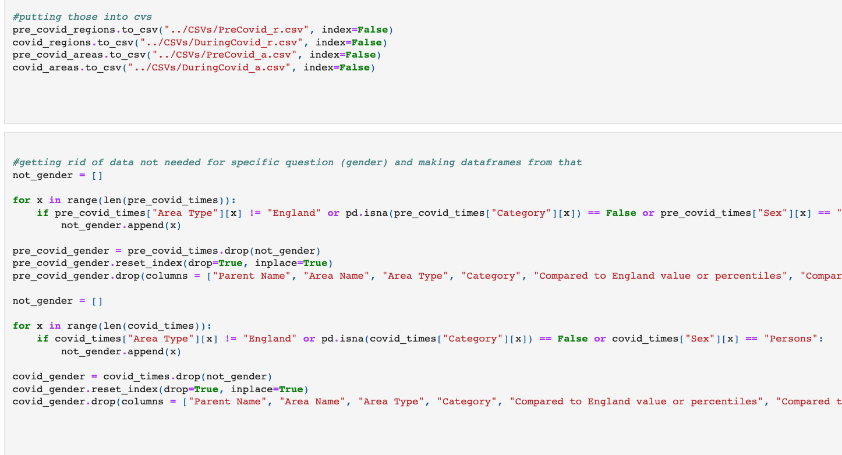
At this point we were satisfied that we had cleaned and prepared the data enough for us to start analysis

Slide 9
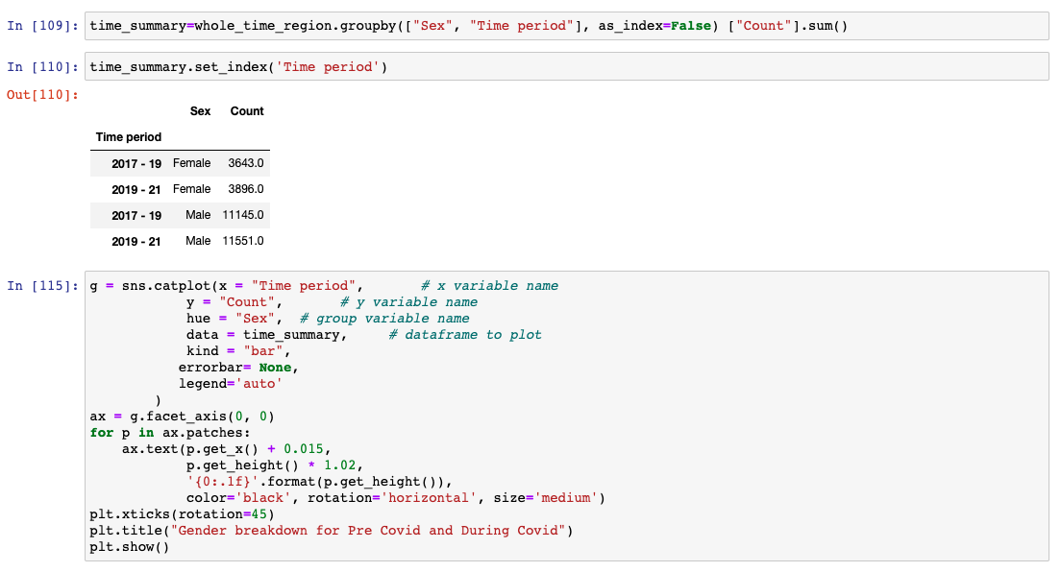
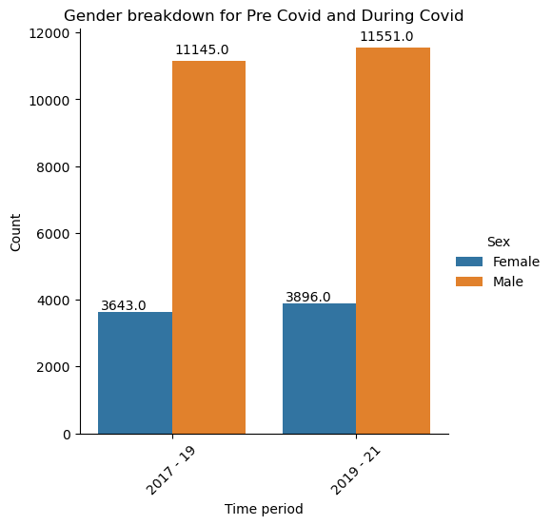
Question 1 – Comparing the rates of suicide broken down by Gender during and pre Covid 19

Slide 10
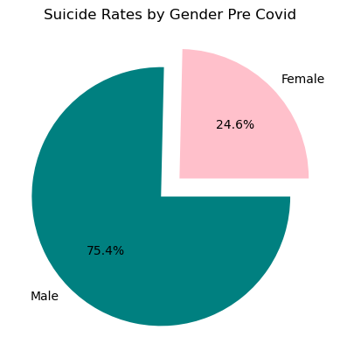
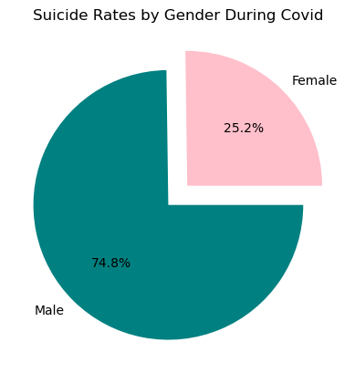
Suicide Rates by Gender

Slide 11
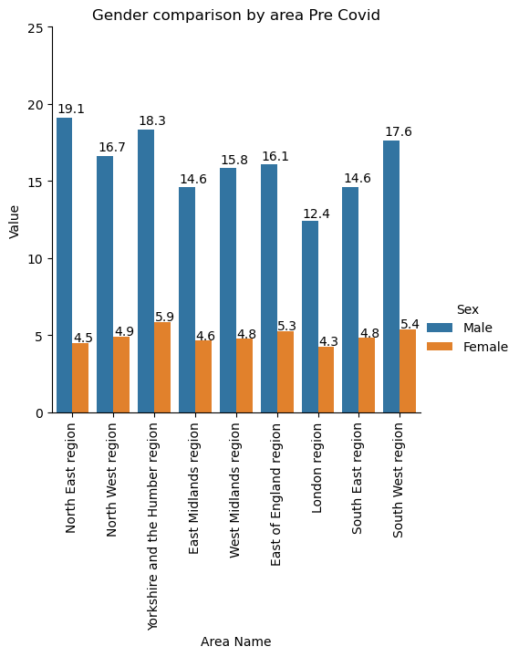
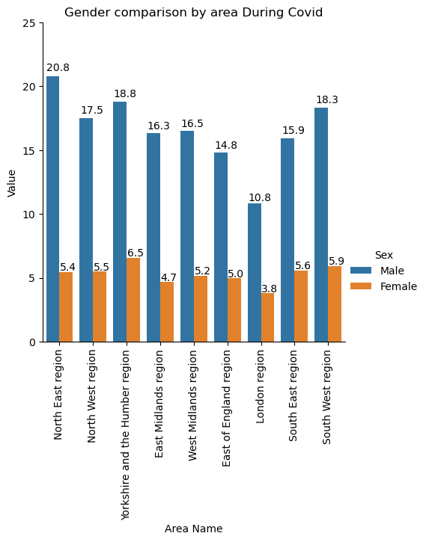

Slide 12
Analysis
The overall rate for suicides went up over the period during Covid
The percentage increase was higher for women than men when comparing the time periods, the male rate increased by 3.64% and the female increased by 6.94%
The split between genders is still overwhelmingly male, however during Covid the split went more in favour of the female gender.
The gender split over the charts comparing the time periods generally followed the same pattern and increased during covid.

Slide 13
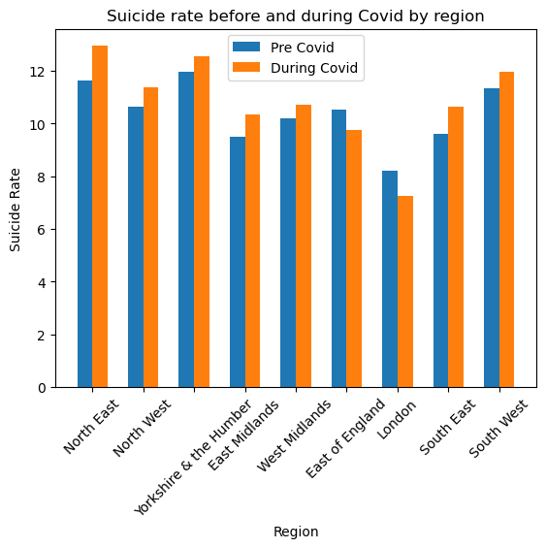
The North West had the highest rate of suicide per 100000 people pre Covid, however duringCovid the North East had the higher rate. The only regions to have a decline in rates were the East of England and London. All other regions the suicide rates rose during the pandemic. Looking at the data, the area with the largest increase in the pandemic was the North East.
Question 2 – How did Covid affect the Suicide rates in each region?

Slide 14
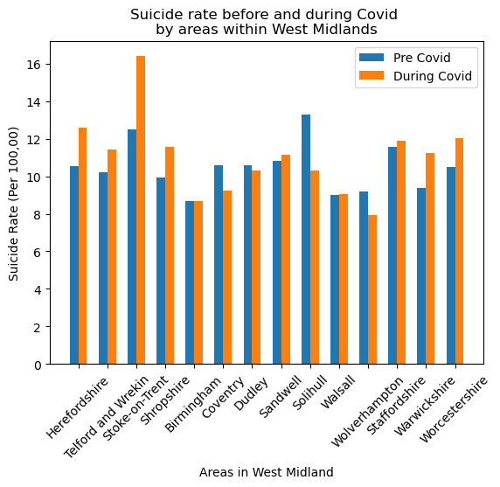
West Midlands Map
We decided to have a more in depth look at the West Midlands area as we are all based there.
Although Solihull pre-Covid had the highest suicide rate, it was Stoke-on-Trent that had the highest rate during Covid. Interestingly, Solihull had the biggest drop during the pandemic and had one of the lowest rates of suicide during Covid-19.

Slide 15
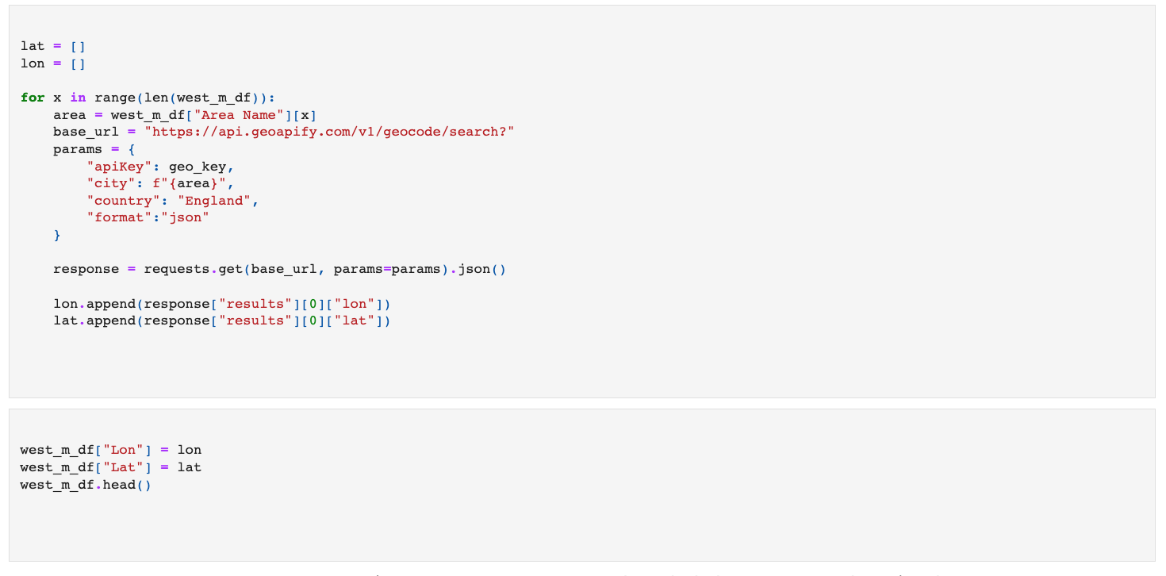
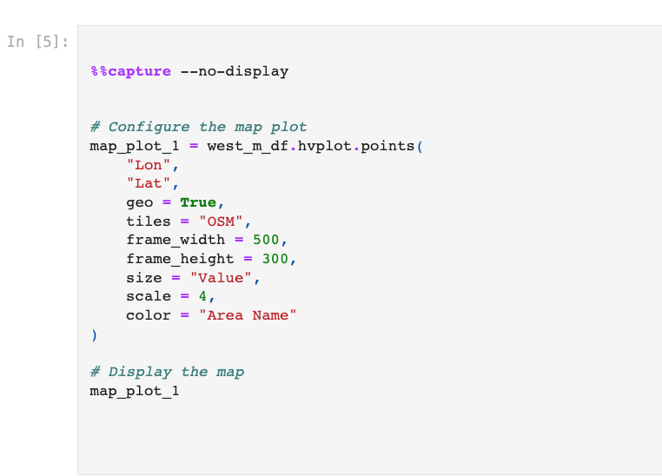
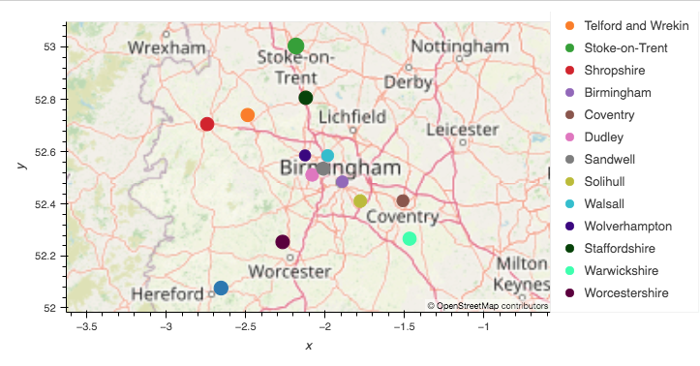
West Midlands API

Slide 16
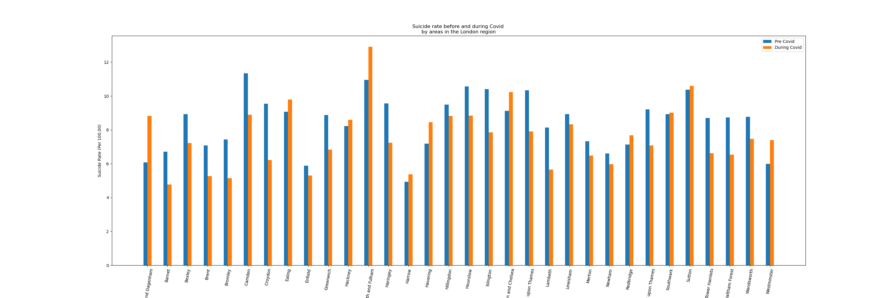
London Suicide Effects
We also wanted to investigate why London had a decrease during the pandemic and explored the areas of London more.
Certain areas within London: Bromley, Barnet and Houndslow, dropped rates
However, Barnet, Ealing, Chelsea and Fulham had an increase in suicides during Covid

Slide 17
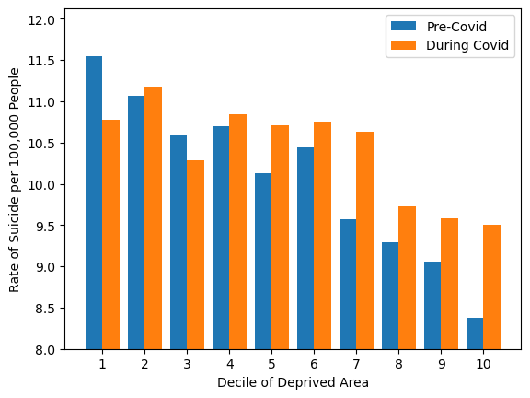
Question 3 - How did Covid affect the suicide rates in different areas of depravation?
We compared the areas of the UK by decile of deprivation.
When looking at the chart displayed we could see a trend in the lower and upper deciles.
The most deprived area had a massive drop in suicide rate, during the pandemic and the upper deciles had a sharp increase during it.

Slide 18
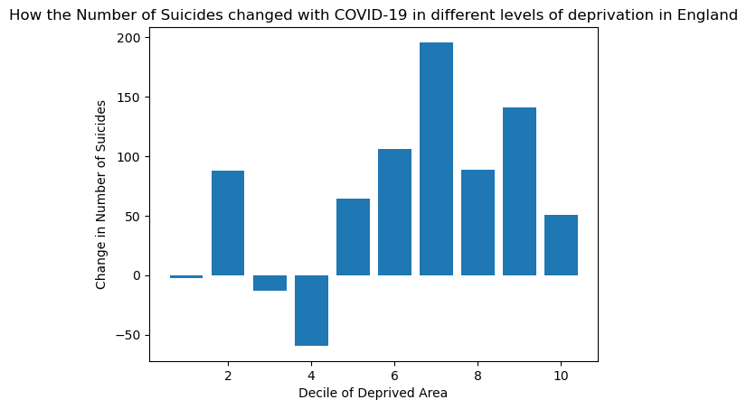
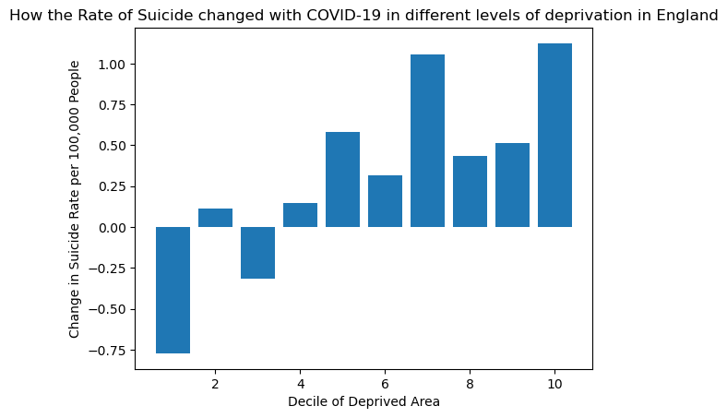
Looking at the change rate per decile of deprived area during Covid

Slide 19
Analysis
The sharp decrease in the more deprived deciles needed more investigation so we produced change rate visualisations to provide further insights.
The charts didn’t seem to support the sharp decrease as the change in counts (total suicides in the area) slightly rose.
From this we had to conclude the most deprived areas increased in size during covid causing this change and the decrease in value per 100000 people.

Slide 20
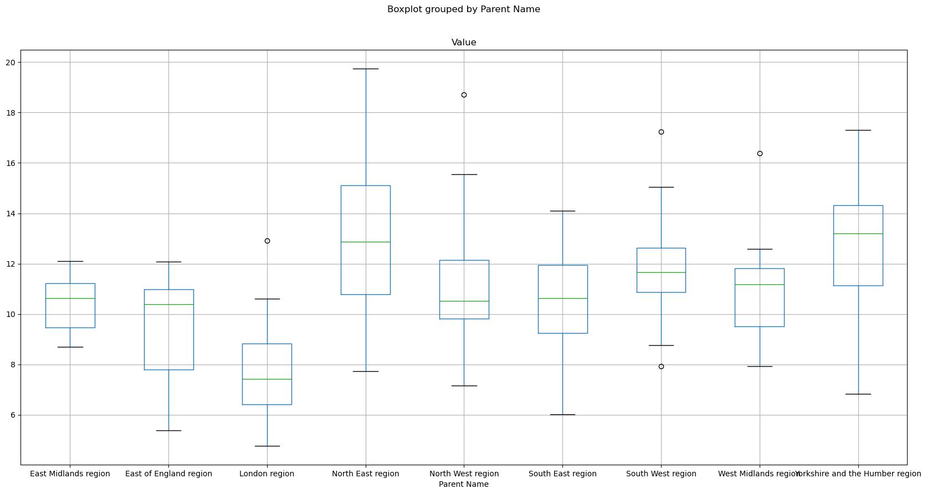
Box Plots and a P Value

Slide 21
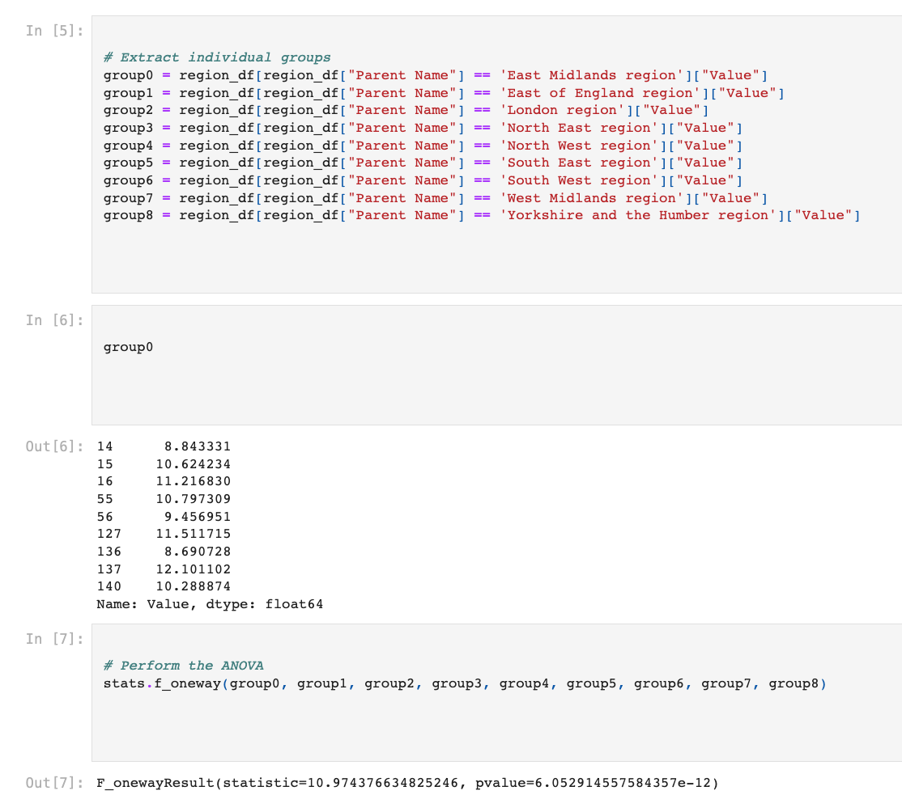
P Value Calculation

Slide 22
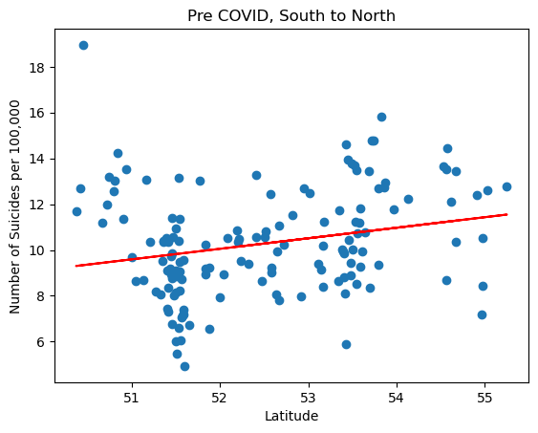
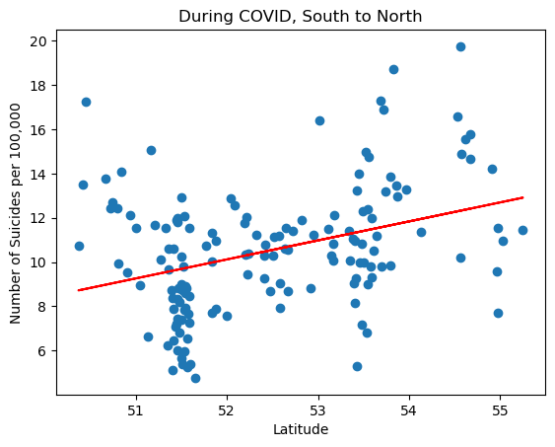
Regression Charts detailing the North to South Comparison
Our graphs show there is a slight trend between the latitude and the suicide rate per 100000, which seemed to increase during Covid. The r value pre Covid was 0.23 and during Covid was 0.35 showing an increase in the trend.

Slide 23
Overall Findings
Hypothesis was correct – the data proved this.
P Value – This was a value of 6.5, and signifies that it rejects the null hypothesis and the value of suicides is significantly different between regions.
We can say suicides do vary by region and are higher in the North.
The areas when classified by deprivation showed us that there was a pattern in the extremes of the scale
Covid led to a higher rate of suicides in females, they had a bigger share of the total suicide rate when split by gender.

Slide 24
Any Questions?

